Slide 1
Previous Lecture
organisational aspects
What is hydrogeology?
groundwater as part of the global water cycle
volume and mass budgets
Questions?

Slide 2
Today
structure of the subsurface
grain size distribution of unconsolidated porous media
subterranean water
* The lecture texts/contents are originally from Prof. R. Liedl. Only minimal modifications have been made to the original texts/contents.

Slide 3
Structure of the Subsurface

Slide 4
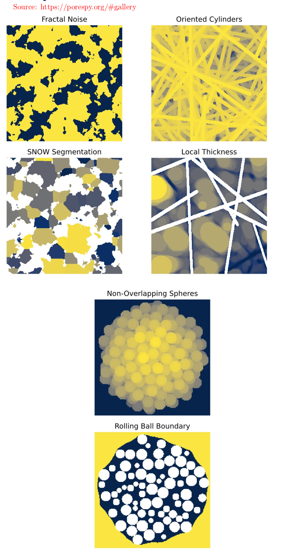
Porous Medium
A porous medium or a porous body is a solid containing voids (or holes).
The subsurface can be regarded a porous medium.
Voids may have very different shapes (interstitial between ball-like grains, planar crack-like fractures, cylindrically shaped tubes or conduits etc.)
Voids may be connected to or disconnected from each other.
Voids may contain fluids (mostly air and/or water).
Size, shape and connectivity of voids are influential for the ability of the porous medium – to store water – to transmit water

Slide 5
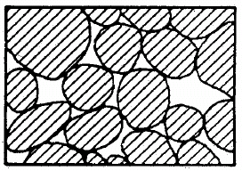
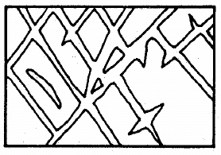
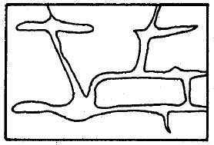
Types of Porous Media in the Subsurface
sediments
rocks
fractured
karstified
unconsolidated
porous medium
(formation due to deposition of solid
material mostly
by water)
consolidated
porous medium
(formation of rocks due to
increased pressure acting
together with thermal
and chemical processes)

Slide 6
Unconsolidated Porous Medium
(Klingbeil, 1998)
sediments consisting of fluvial deposits of sands and gravels
(Rhine Basin – Southwest Germany/Northern Switzerland)

Slide 7
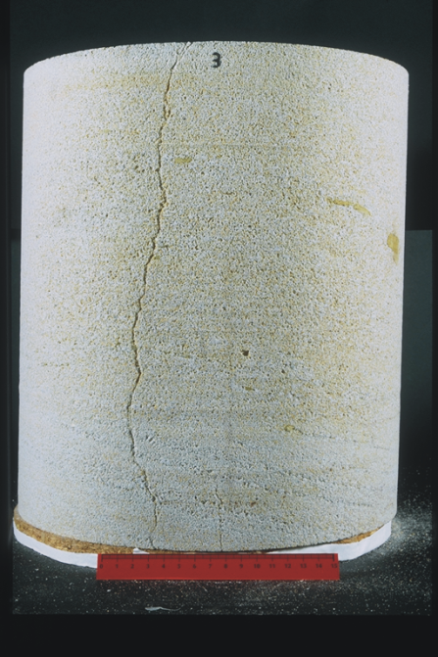
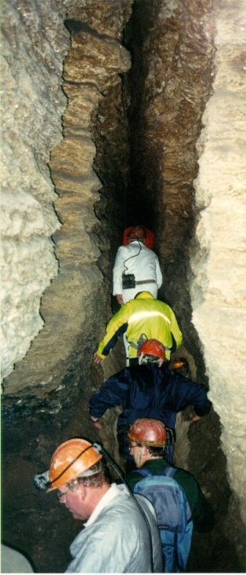
Consolidated Porous Media
34 cm
Sandstone
(South Germany)
Gypsum
(Western Ukraine)
Fractured porous medium: Genesis of fractures or cracks due to mechanical or thermal processes (stress/strain or cooling/warming)
Karstified porous medium: Genesis of fractures or tubes (conduits) due to chemical processes (i.e. dissolution of rock by water)

Slide 8
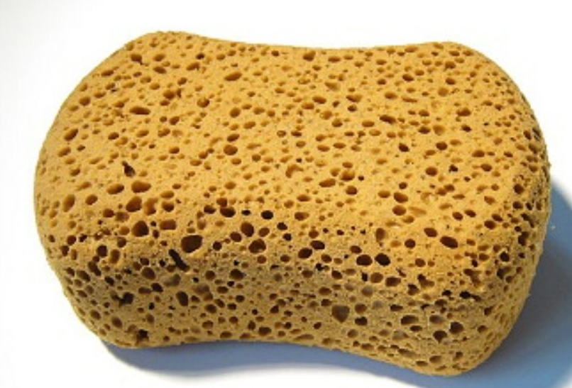
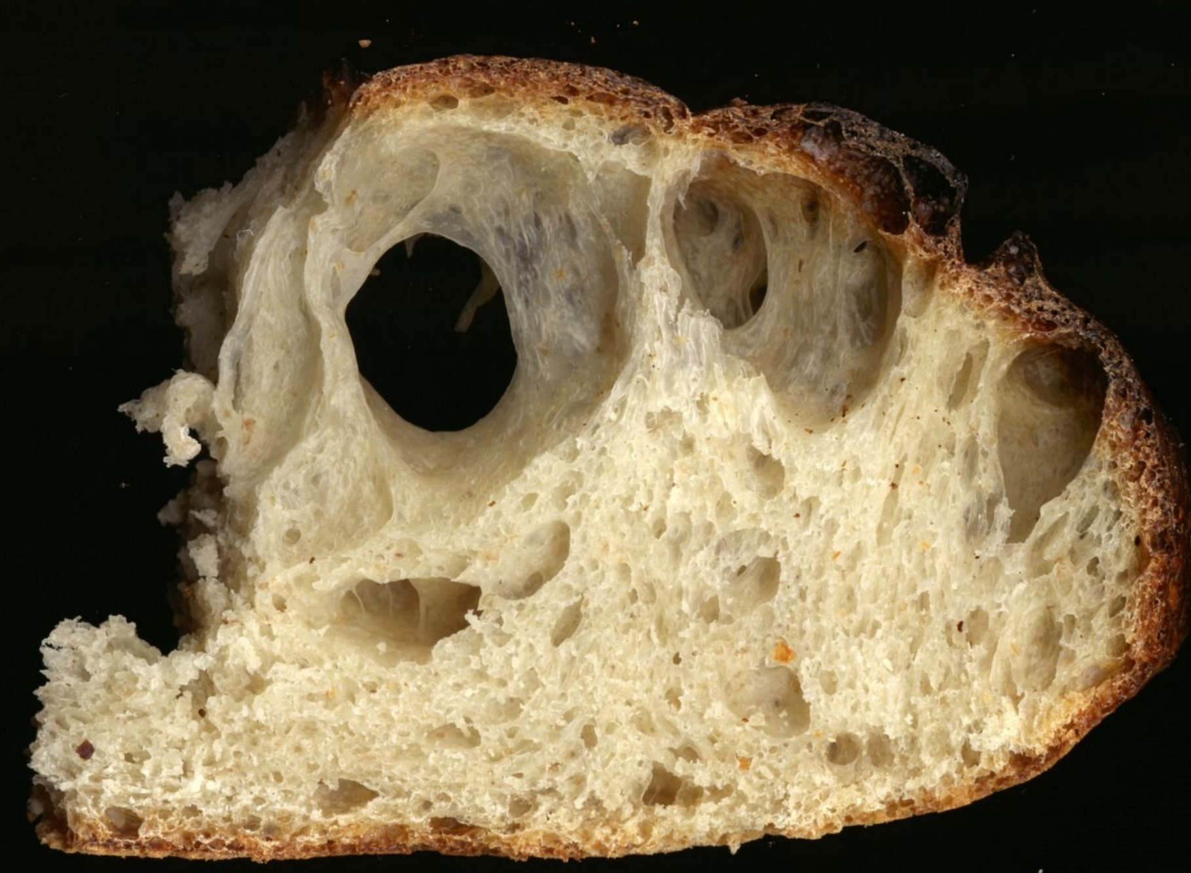
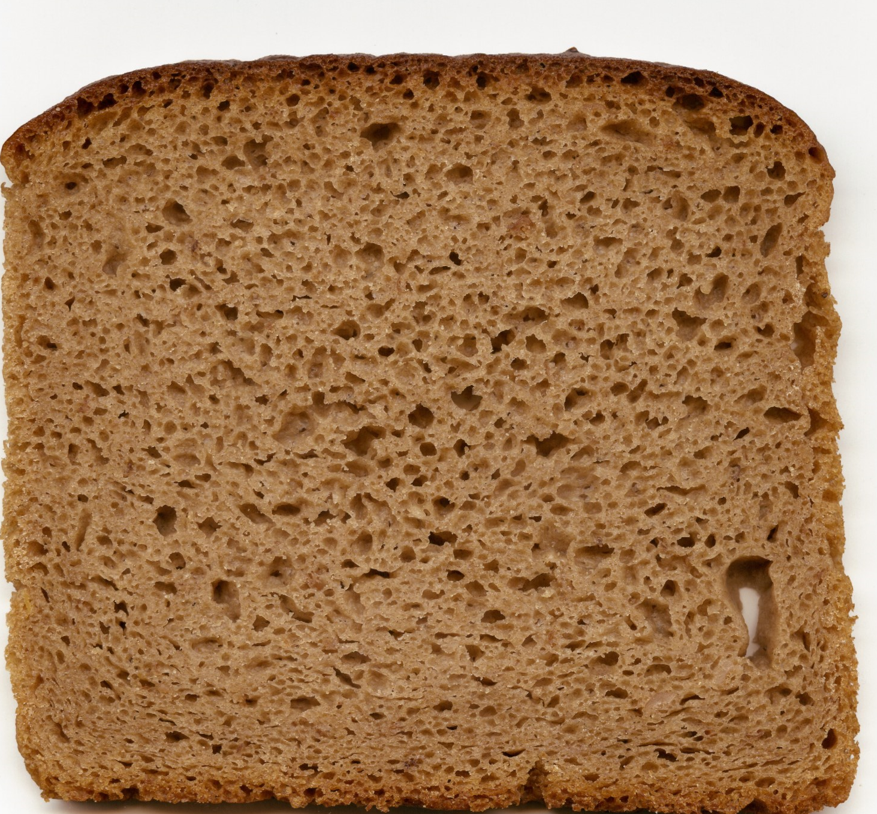
Porosity
Sponge
Porosity (or more precise: total porosity) is defined as the volumetric share of voids in a porous medium:
void volume [L³]
https://energyeducation.ca/encyclopedia/Porosity
Sourdough bread
total porosity [-]
total volume [L³]
Rye bread
Total porosities can be given either as numbers between 0 and 1 or as percentages between 0% and 100%.
https://en.wikipedia.org/wiki/Pore_(bread)

Slide 9
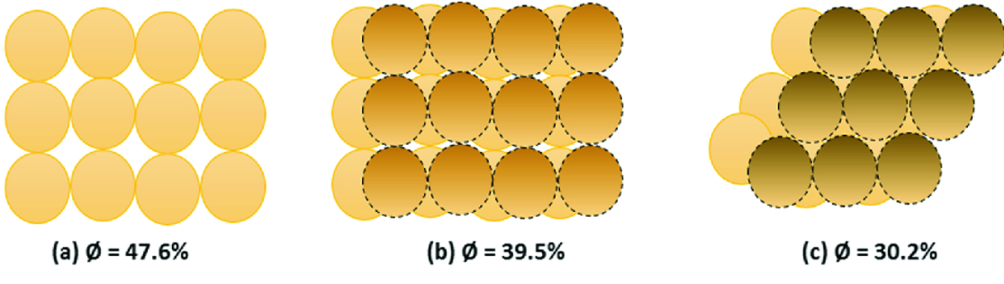
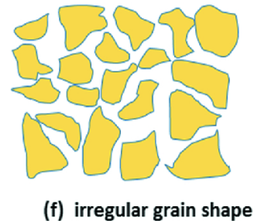
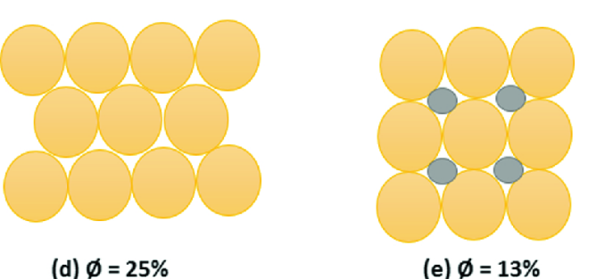
Total Porosity of Artificial Porous Media
If „grains“ have identical shape and are regularly arranged, it is possible to exactly compute total porosity, e.g. for packed spheres of same size.
“loose packing“
“dense packing“
Exact computation of porosity is not possible
Figure Source: https://doi.org/10.1007/978-3-030-28140-3_2

Slide 10
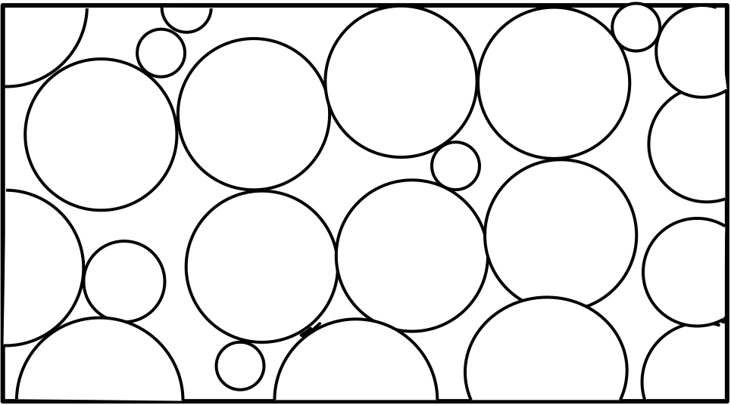
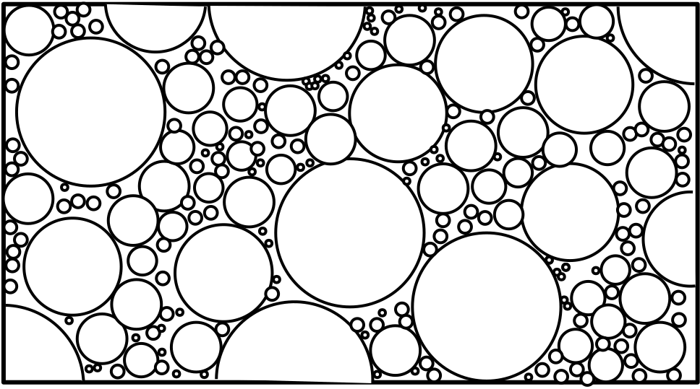
Total Porosity of Natural (Unconsolidated) Porous Media
Natural unconsolidated porous media consist of grains of different size.
Total porosity depends on the grain size distribution.
“well sorted“
(= grain diameters cover a small range)
“poorly sorted“
(= grain diameters cover a large range)
In general, well sorted unconsolidated porous media exhibit larger total porosities than poorly sorted unconsolidated porous media (in the above example: 32% vs. 17%)

Slide 11
Typical Porosity Values
unconsolidated porous media
consolidated porous media
 | grain diameter (mm) | total porosity (%)
coarse gravel | 20 – 60 | 24 – 36
fine gravel | 2 – 6 | 25 – 38
coarse sand | 0.6 – 2 | 31 – 46
fine sand | 0.06 – 0.2 | 26 – 53
silt | 0.002 – 0.06 | 34 – 61
clay | < 0.002 | 34 – 60
 | total porosity (%)
siltstone | 21 – 41
sandstone | 5 – 30
basalt | 3 – 35
claystone | 1 – 10
limestone | 1 – 10
shale | < 10
granite | < 1
Total porosity of consolidated porous media (rocks) is usually smaller than total porosity of unconsolidated porous media. However, weathering effects may lead to increased values.
For unconsolidated porous media, total porosity tends to increase with decreasing grain size.

Slide 12
Grain Size Distribution of Unconsolidated Porous Media

Slide 13
Introductory Remarks
The ability of unconsolidated porous media to transmit water is highly dependent on the grain size distribution.
The grain size distribution is therefore frequently determined in laboratory experiments in order to deduce important flow properties.
There are five major grain size classes (ordered by increasing diameter): clay, silt, sand, gravel, cobbles (or debris)
The classes for silt, sand and gravel are usually subdivided by “fine“, “medium“, and “coarse“ (or “very fine“, “fine“, “medium“, „coarse“, and “very coarse“).
Different ranges for individual grain size classes have been defined by different authorities or regulators!
The standard method to determine the grain size distribution of a sample is sieve analysis.

Slide 14
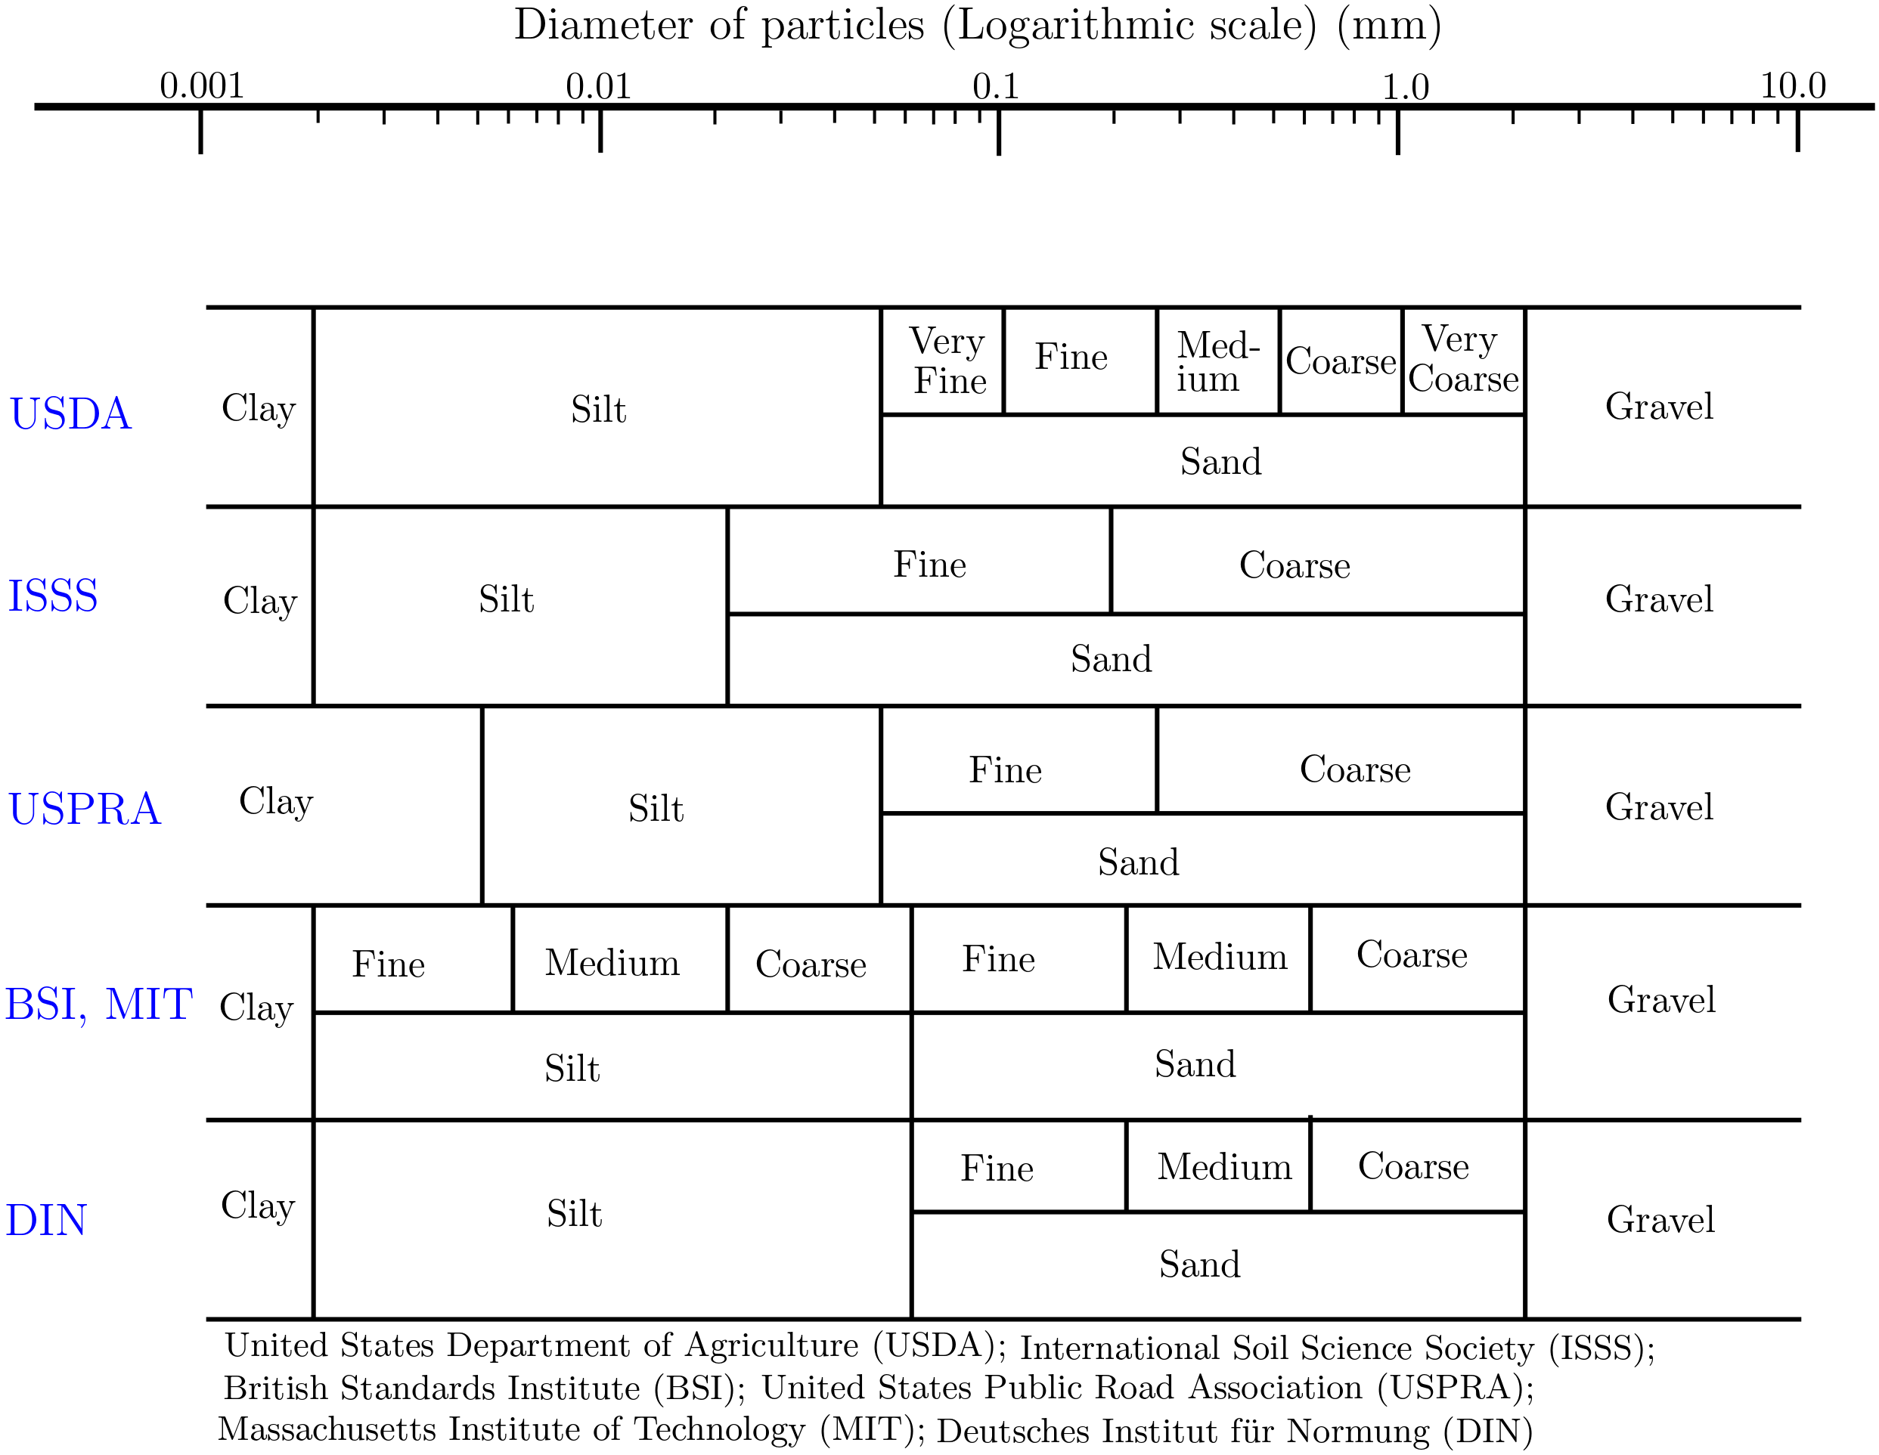
Classification Schemes
The diagram below includes a couple of classification schemes to define ranges of grain diameters for clay, silt, sand, and gravel.

Slide 15
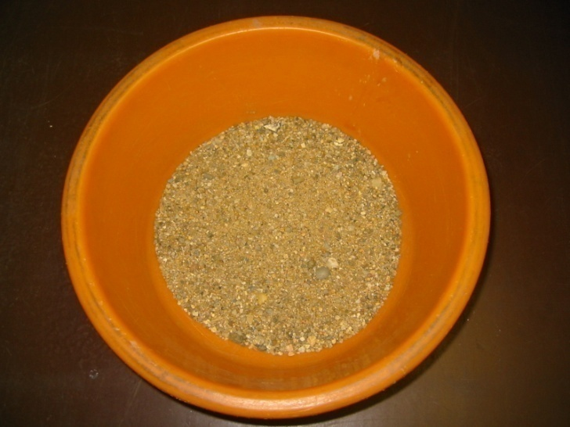
Sieve Analysis
granulometric curve
Sample consists of different grain size fractions
cumulative mass fraction (%)
grain diameter (mm)

Slide 16
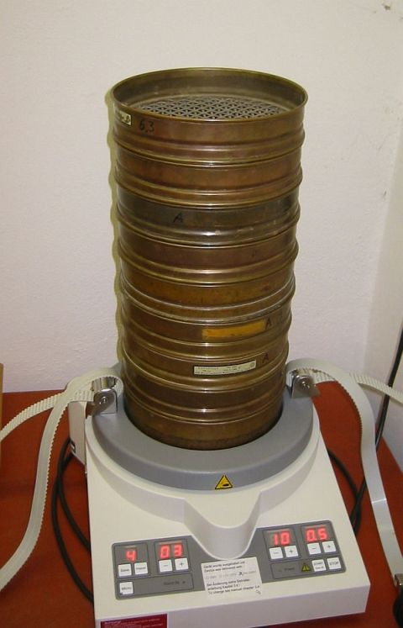
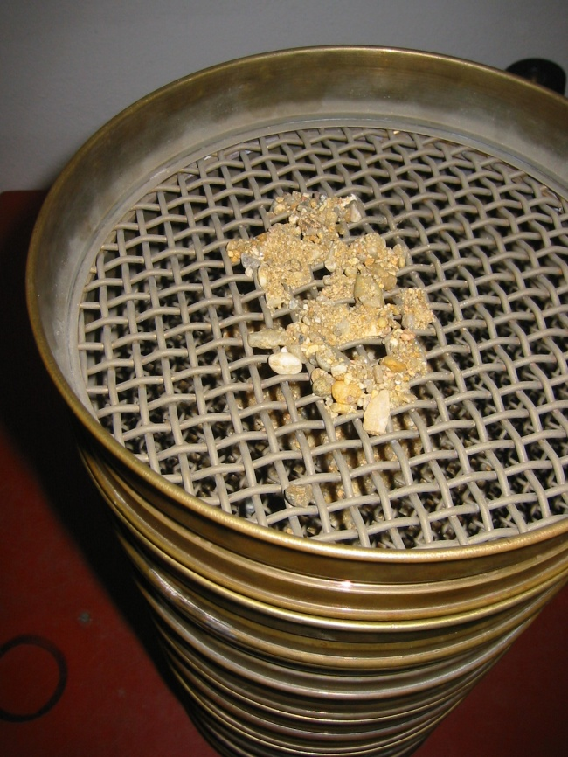
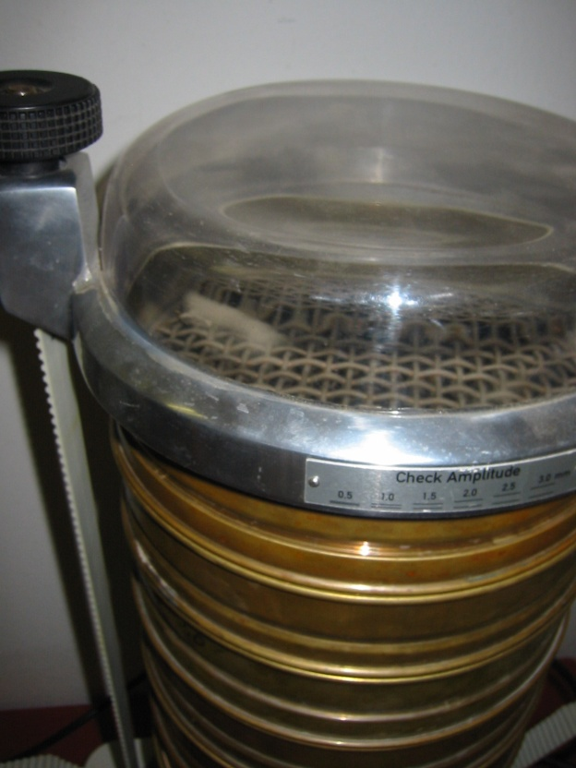
Sieving Machine

Slide 17
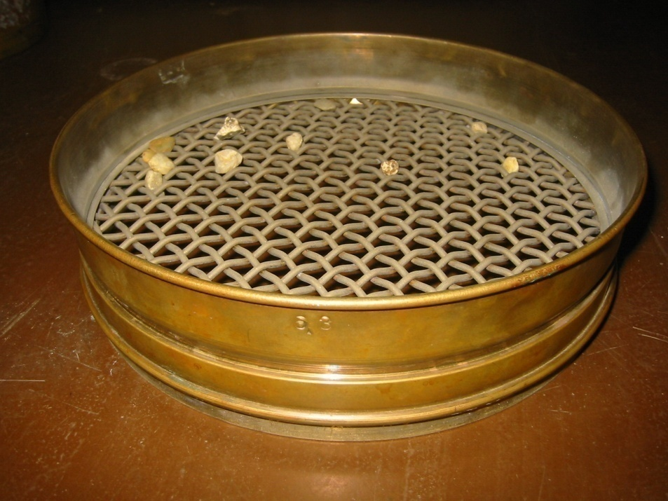
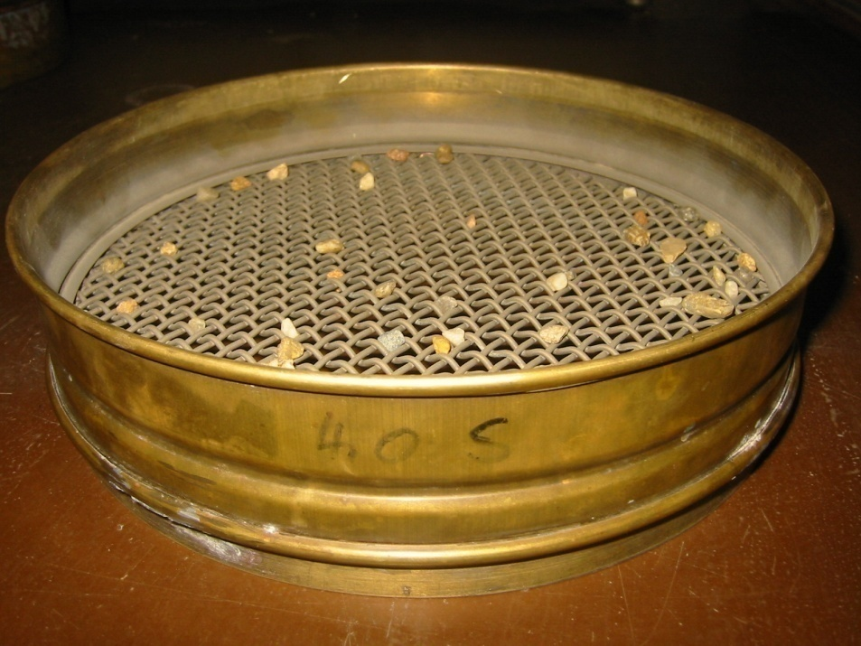
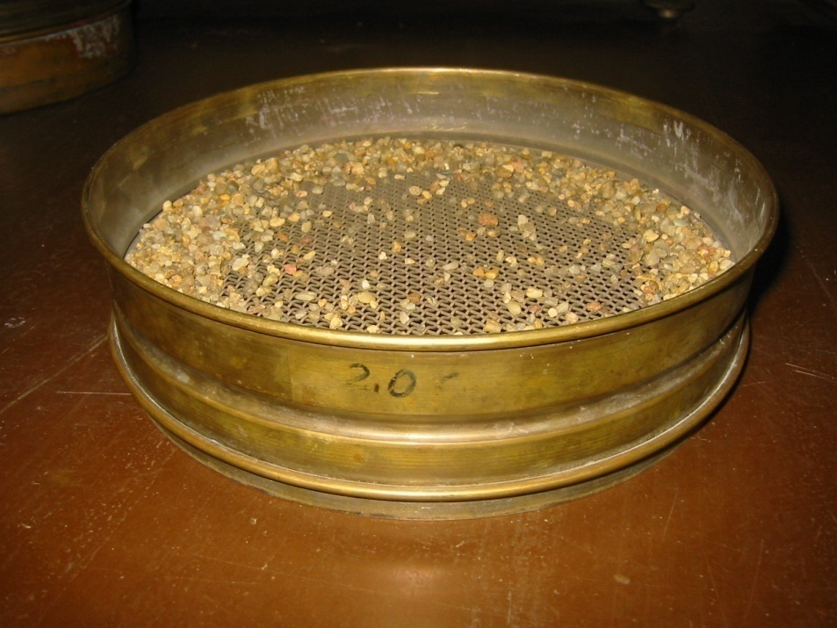
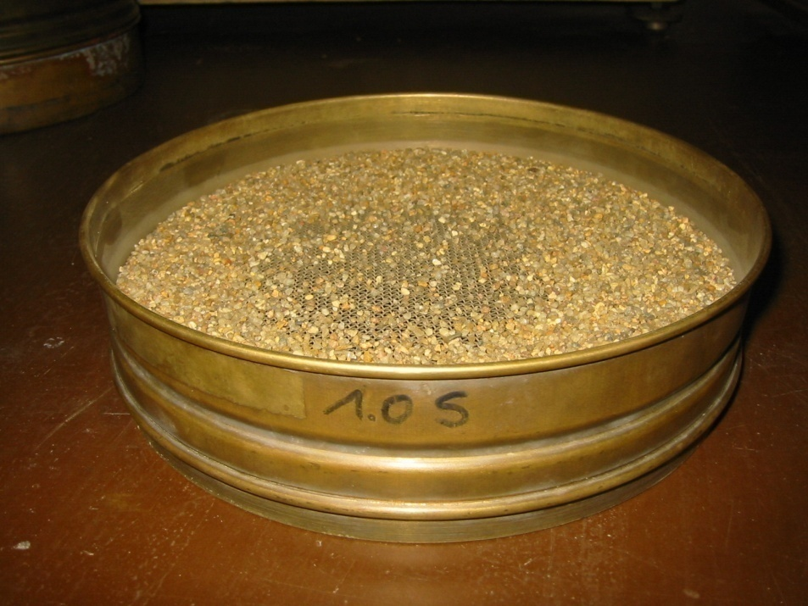
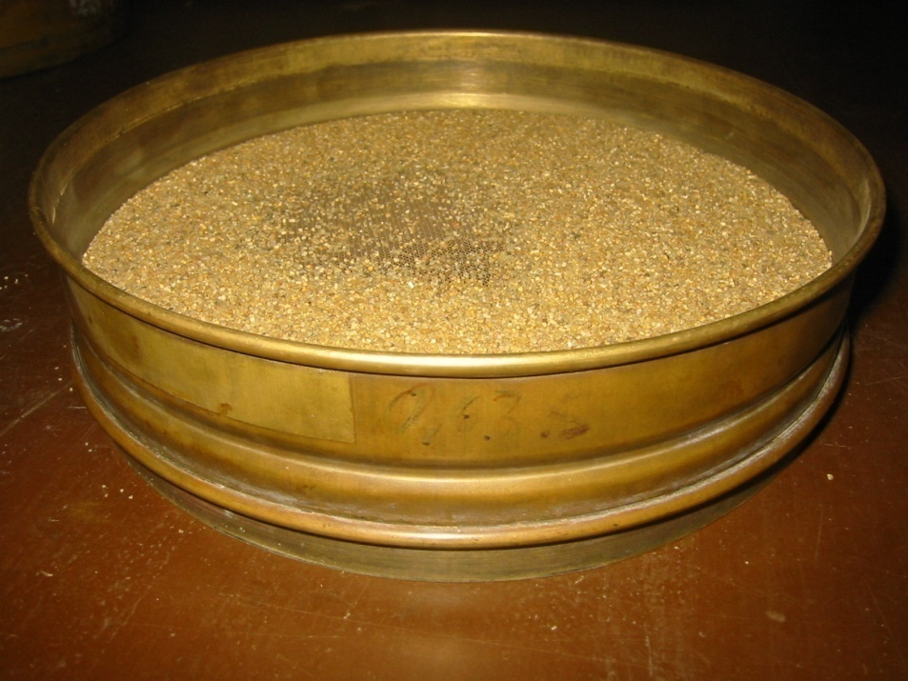
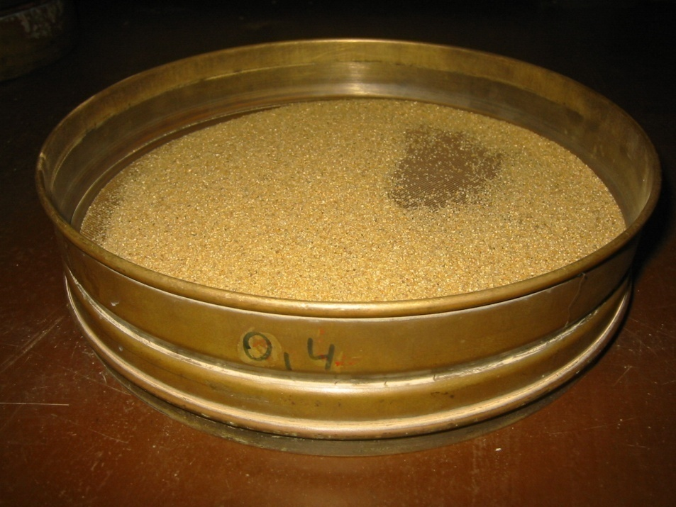
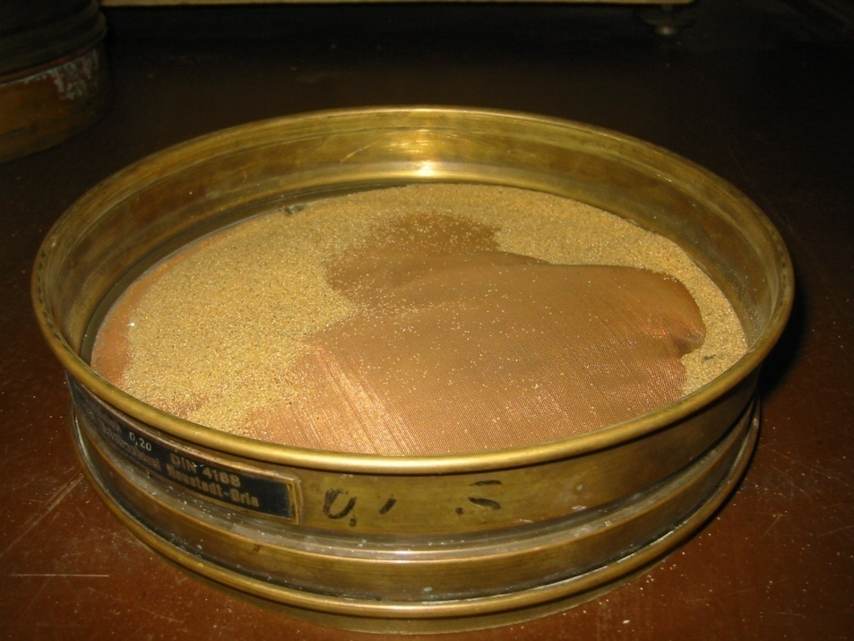
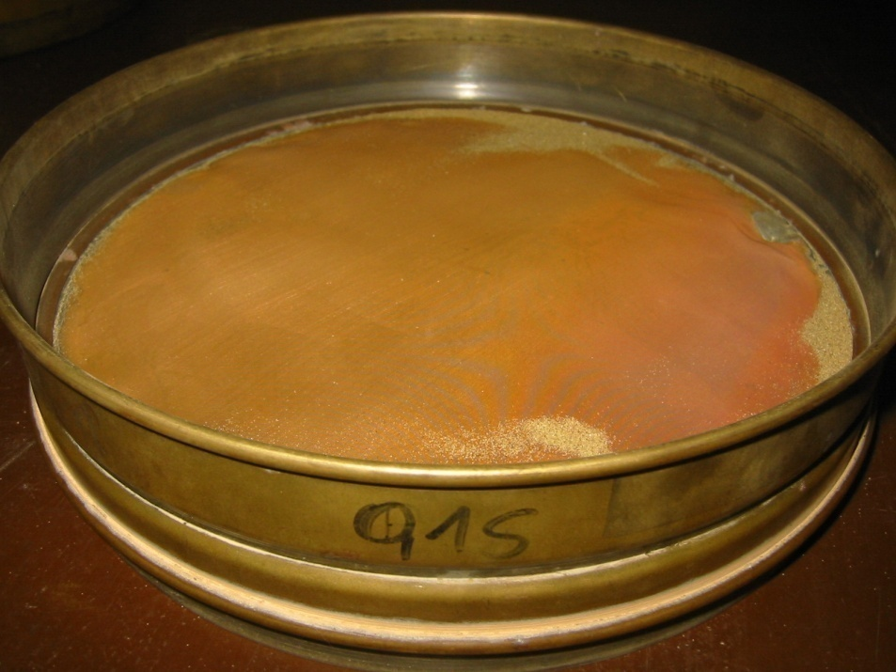
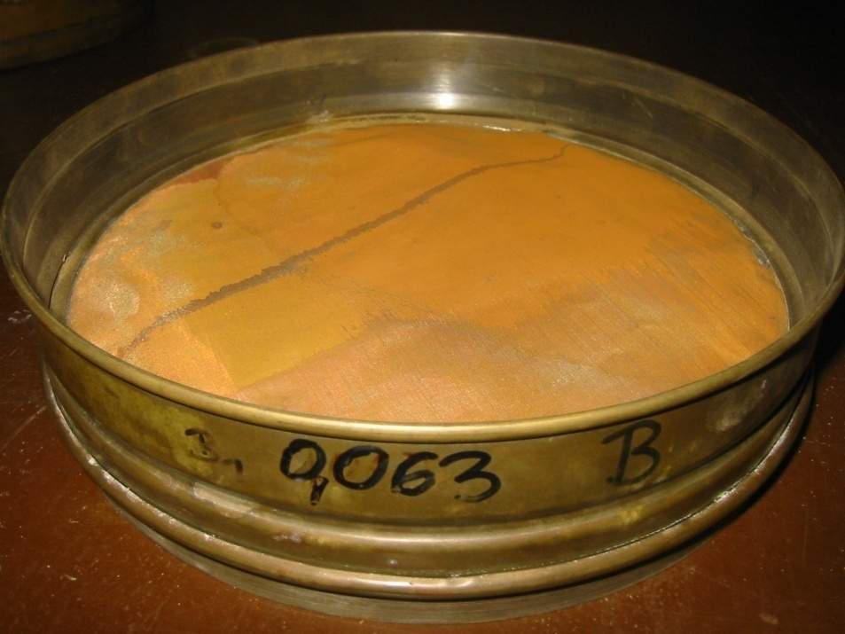
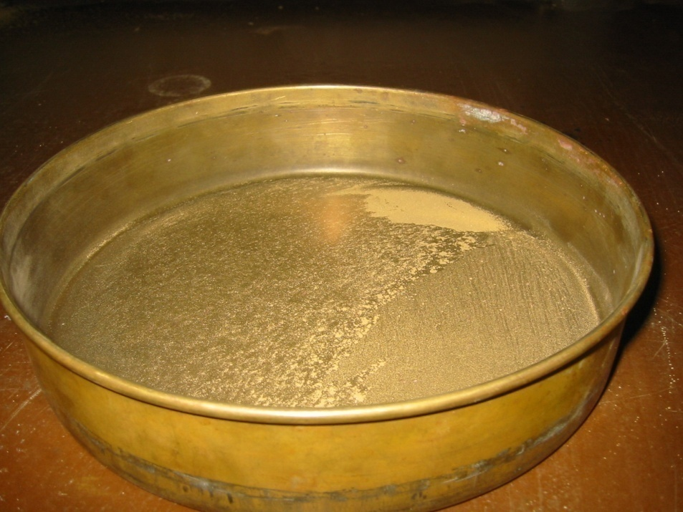
Result
6.3
(diameters in mm)
2.0
0.63
0.2
0.063
4.0
1.0
0.4
0.15
< 0.063

Slide 18
d_{x} and U
d_{x} denotes the grain diameter for which x % (in mass or weight, not volume!) of the sieved material is smaller than this diameter.
Grain diameters d₁₀, d₆₀ and d₇₅ are of practical importance with regard to groundwater flow properties.
The ratio of d₆₀ and d₁₀ is called coefficient of uniformity U :
cumulative mass fraction (%)
x
d_{x}
d₇₅ is specifically used for well construction purpo-ses (not covered by this lecture).
grain diameter (mm)

Slide 19
Example: Sieve Analysis
silt
sand
gravel
de-
bris
sieve analysis

Slide 20
Subterranean Water

Slide 21
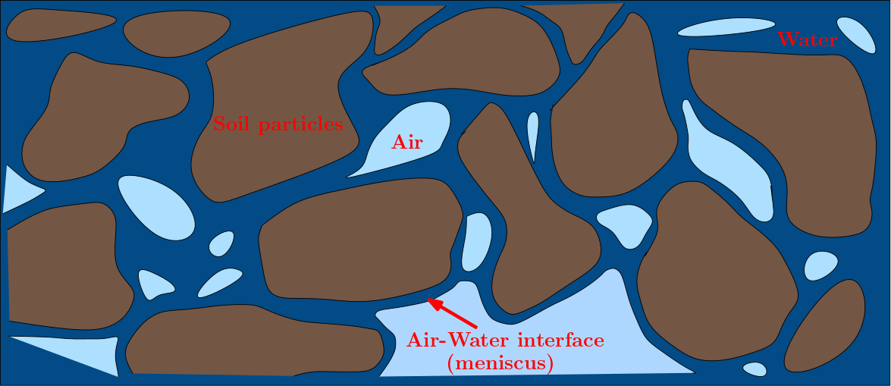
The Subsurface as a Three-Phase System
In general, voids in the subsurface are partly occupied by air and water.
The subsurface can therefore be seen as a three-phase system consisting of a solid phase, a water phase, and a gas phase.
A schematic illustration for voids or pores in an unconsolidated porous medium is given in the figure.

Slide 22
Some More Volume Ratios
The (volumetric) water content is defined as the share of water in the porous medium:
water volume [L³]
water content [-]
total volume [L³]
The water content cannot exceed total porosity, i.e. θ ≤ n.
The degree of saturation is given by the ratio of water volume to void volume:
water volume [L³]
degree of saturation [-]
void volume [L³]
The degree of saturation S equals θ/n.
S may vary between 0 and 1 (or between 0% and 100%).
S = 0: no water in the voids; S = 1: voids are completely filled with water
Notes:
n = Vv/Vt – some voids may be filled with air and so n is always bigger as it accounts for both water and aid voids.

Slide 23
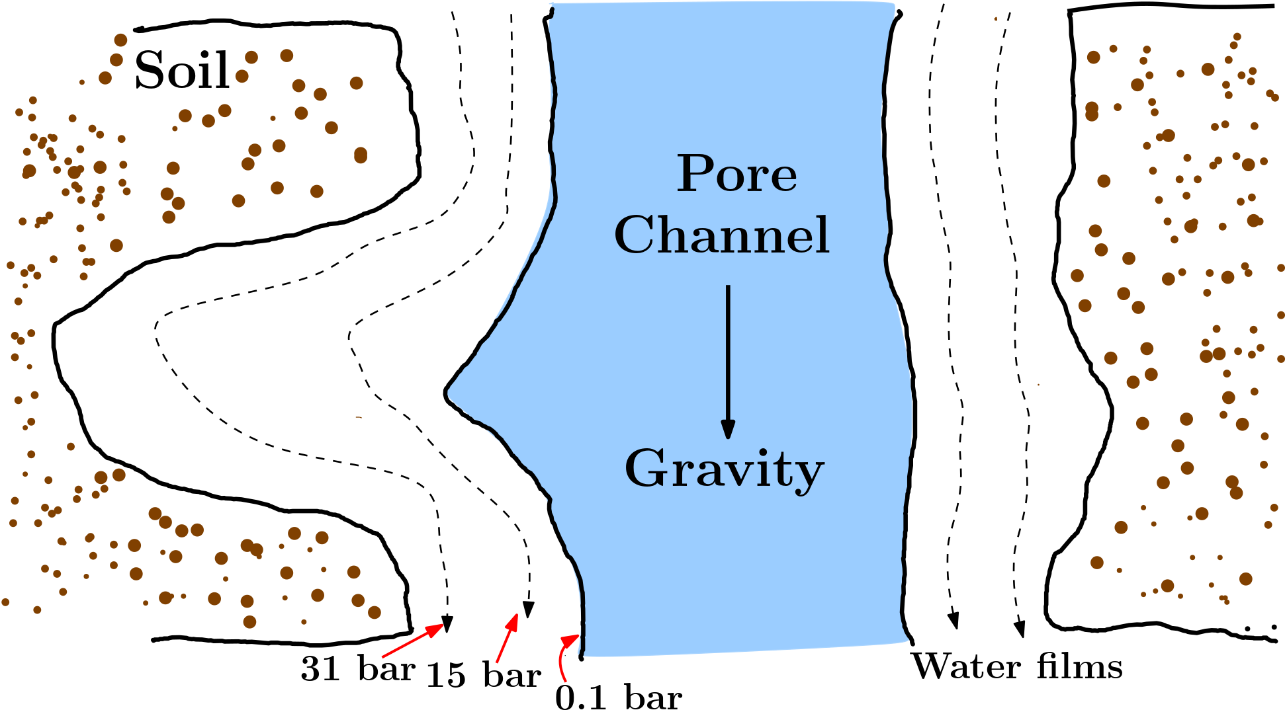
Forces Acting on Subterranean Water
Subterranean water is subject to several forces.
Most important are: – gravity – attractive forces between water molecules (cohesion) – attractive forces between water and solids (adhesion, see figure).

Slide 24
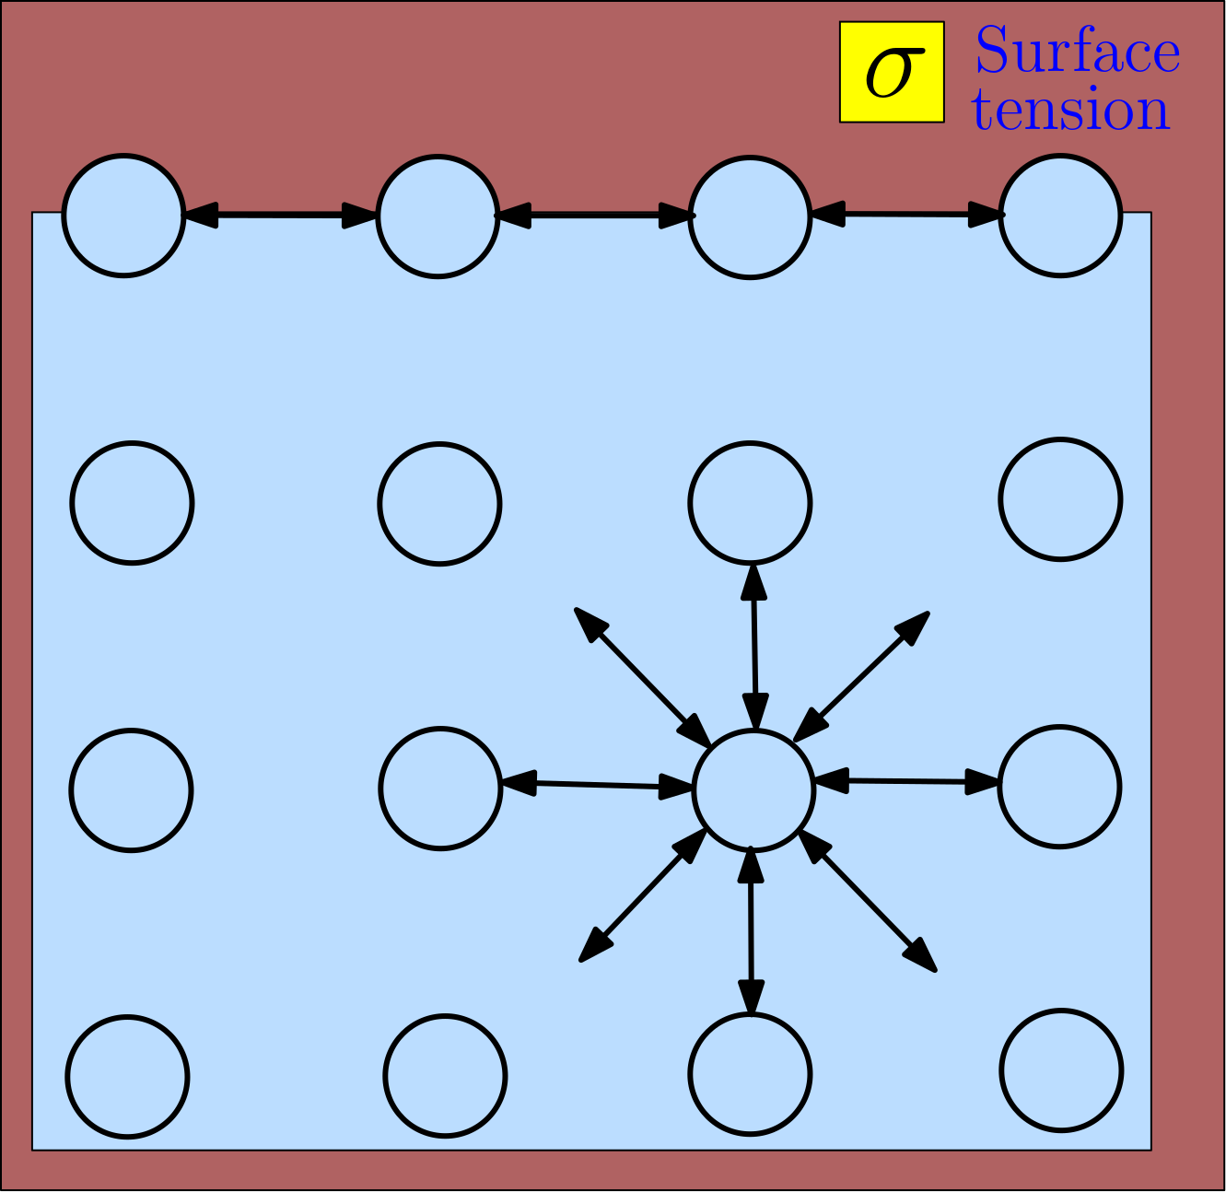
Surface Tension
Cohesive forces acting on a water molecule compensate each other if the molecule is not located near the water-air or water-solid interface.
This is no longer true at an in-terface: cohesive interaction is reduced on one side. The resulting force tends to minimise the interface area.
Macroscopically, this effect is parametrised by the surface tension, which is defined as the energy needed to increase the area of the interface by one unit.
Common units of the surface tension σ are J/m² or N/m. (Its dimension is M/T².)
The surface tension of water is about 7.5·10⁻² N/m at 10°C.
Notes:
Water has among the highest surface tension among the liquid

Slide 25
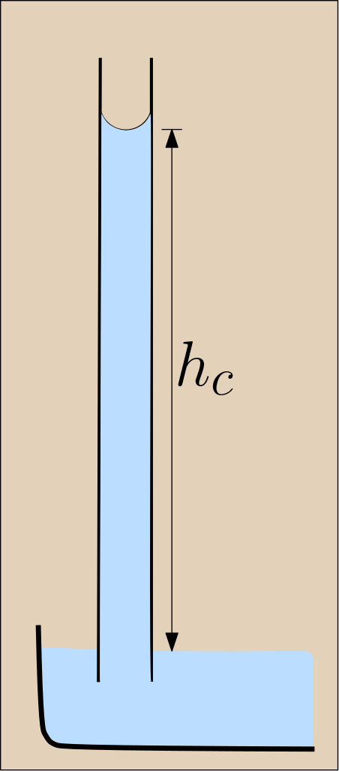
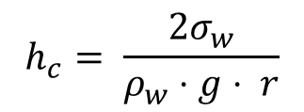
Capillary Action
Water is subject to capillary action when adhesion is stronger than cohesion.
The capillary rise of water in a tube depends on the surface tension and the tube radius.
The maximum(!) capillary rise is given by:
surface tension
of water [M/T²]
$$h_{c}= \frac{2σ_{w}}{ρ_{w}⋅g⋅ r}$$
capillary rise [L]
tube
radius
[L]
density
of water
[M/L³]
acceleration
of gravity
[L/T²]

Slide 26
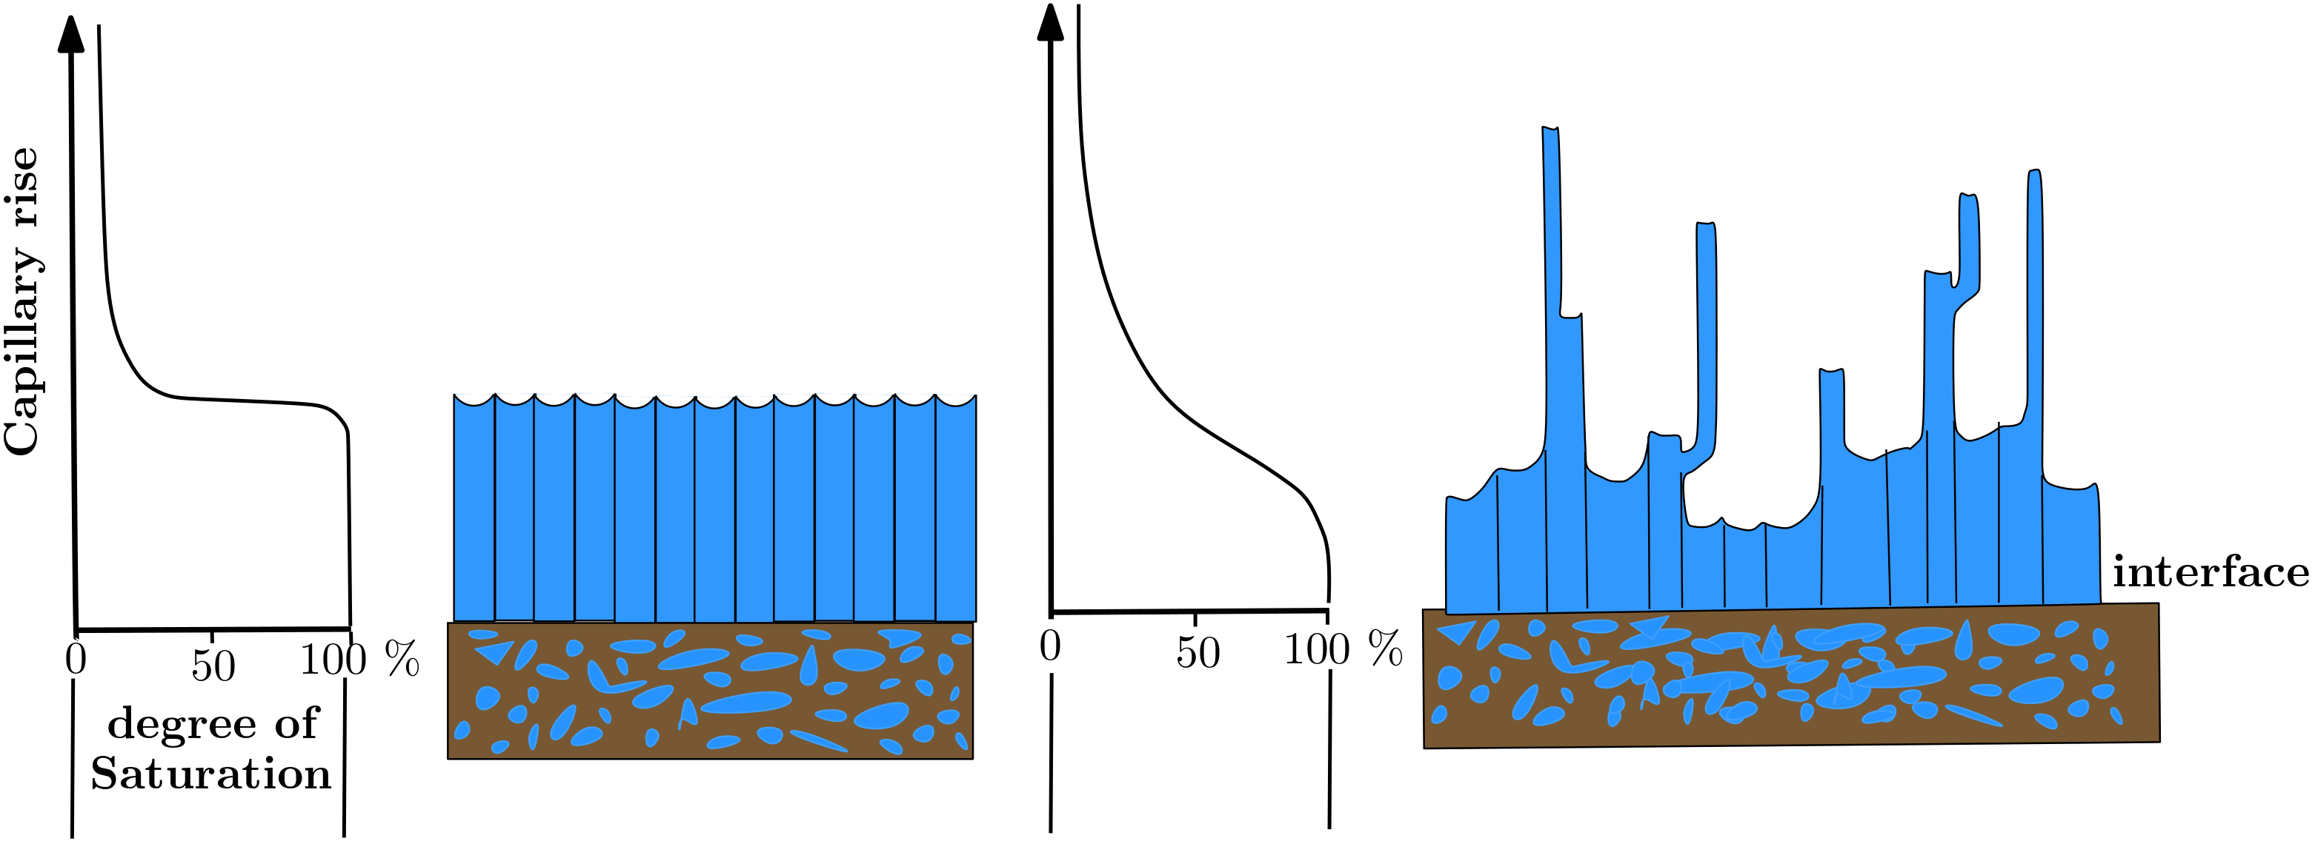
Capillary Action in the Subsurface
Capillary action plays a dominant role in the subsurface.
The capillaries are given by the individual pore channels.
Pore channels in poorly sorted material may strongly differ in diameter, such that a certain variability in capillary rise is observed.
“perfectly sorted
material”
“natural
material”

Slide 27

Quick check what we have understood?
Pls. scan the QR- code
or
click link the link: partici.fi/89145883

